Slide 1


Education through collaborating on real world problems
https://omdena.com/chapters/

Slide 2

Solving community problems using Artificial Intelligence
https://omdena.com/omdena-chapter-page-nigeria/

Slide 3
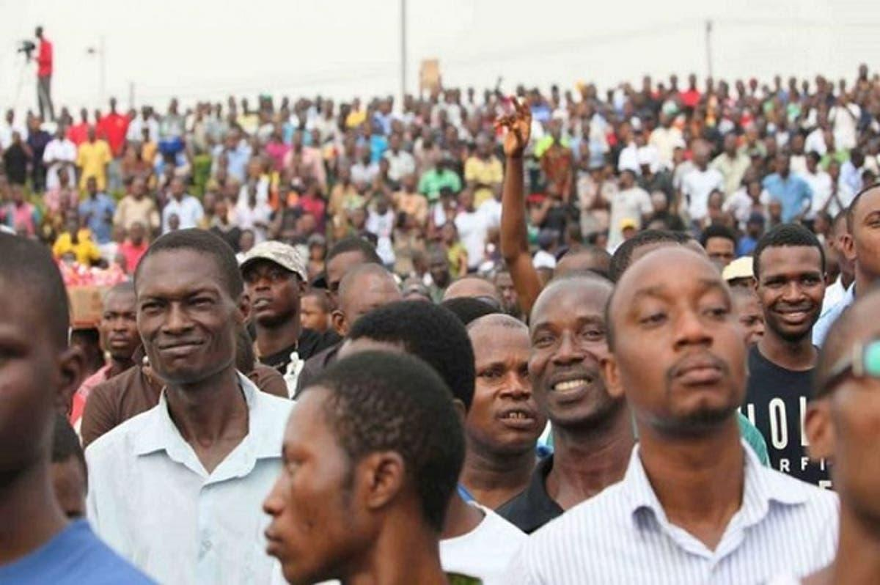
The Project
Solving Unemployment in Nigeria using Artificial Intelligence

Slide 4
Problem Statement
The Unemployment rate in Nigeria increased to 33.30 percent in the fourth quarter of 2020 from 27.10 percent in the second quarter of 2020 while the underemployed rate is 28.7% giving a total percentage rate of 61.9% of Nigerians that are unemployed or underemployed

Slide 5
Project Goals
To create a machine learning model that will merge NYSC graduates with possible job opportunities based on their career path
To provide employable job skills recommendation to NYSC graduates based on their their career path

Slide 6
Week 1: Task done
Data extraction workshop training (recorded)
Data scraped and cleaned

Slide 7
Week 2: Data visualisation
Exploratory Data Analysis
Data visualisation
Modelling
Finding insight from data.

Slide 8

Week 2: Workshop training
Data visualisation by Shahzad Jamil
Exploratory data analysis (EDA) by Obinna Onyema

Slide 9

keep in touch on slack

